Slide 1
Machine Learning
car MAKE-model VERIFICATION

Slide 2
Outline
Dataset manipulation
Structure of the system
The model in detail
Performance evaluation

Slide 3
Dataset manipulation

Slide 4
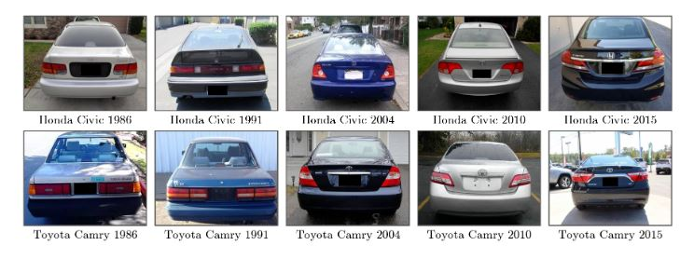
Vehicle Make and Model Recognition Dataset (VMMRdb)
9.170 classes
291,752 images
Link dataset: http://vmmrdb.cecsresearch.org/

Slide 5
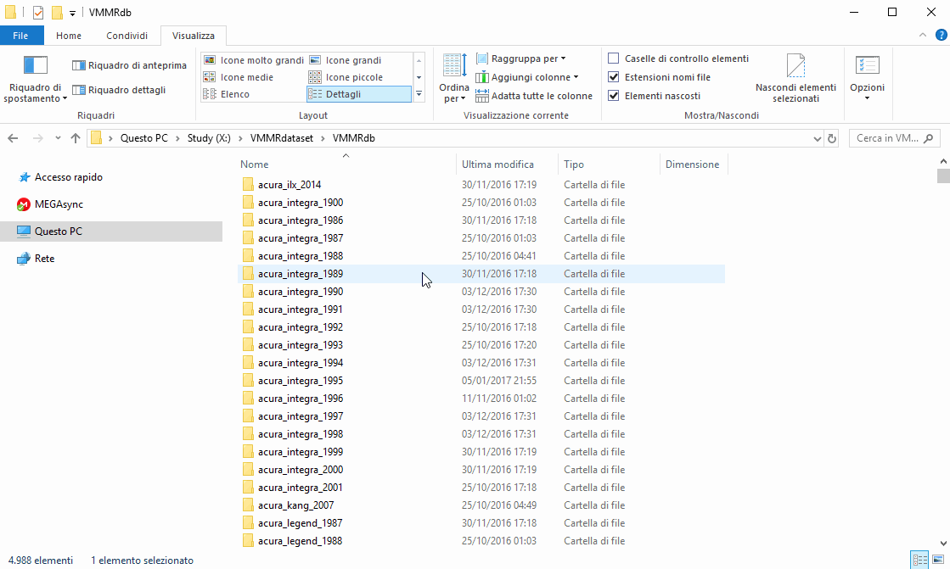
Useful data extraction
extraction/reduction process:
delete all folders of marks that are not contained in the contest list
delete all images not proportional to 200x150 (image size in the contest dataset)
delete all folders with few images (under a certain threshold)

Slide 6
Creation of new samples
NEW DATA:
samples with true label:
combinations of images that are in the same folder
At the end of this process:
32 classes
14k images (of single cars)
samples with false labels: combinations of images that are in different folders

Slide 7
Structure of the system
Notes:
Let's talk about the structure of our system

Slide 8
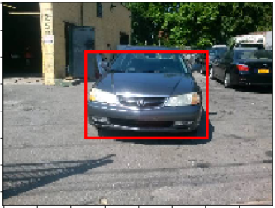
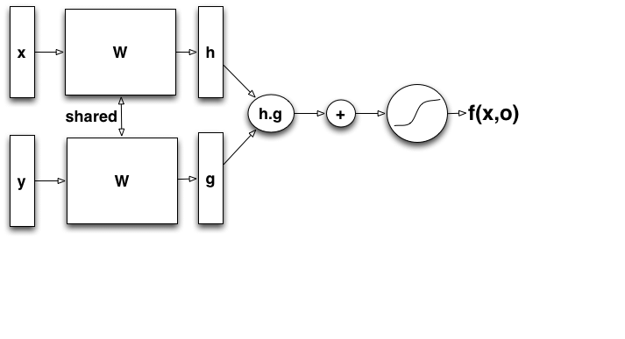
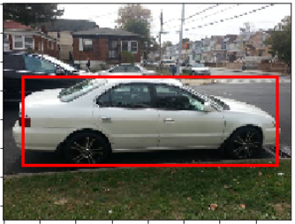
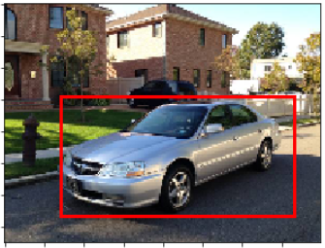
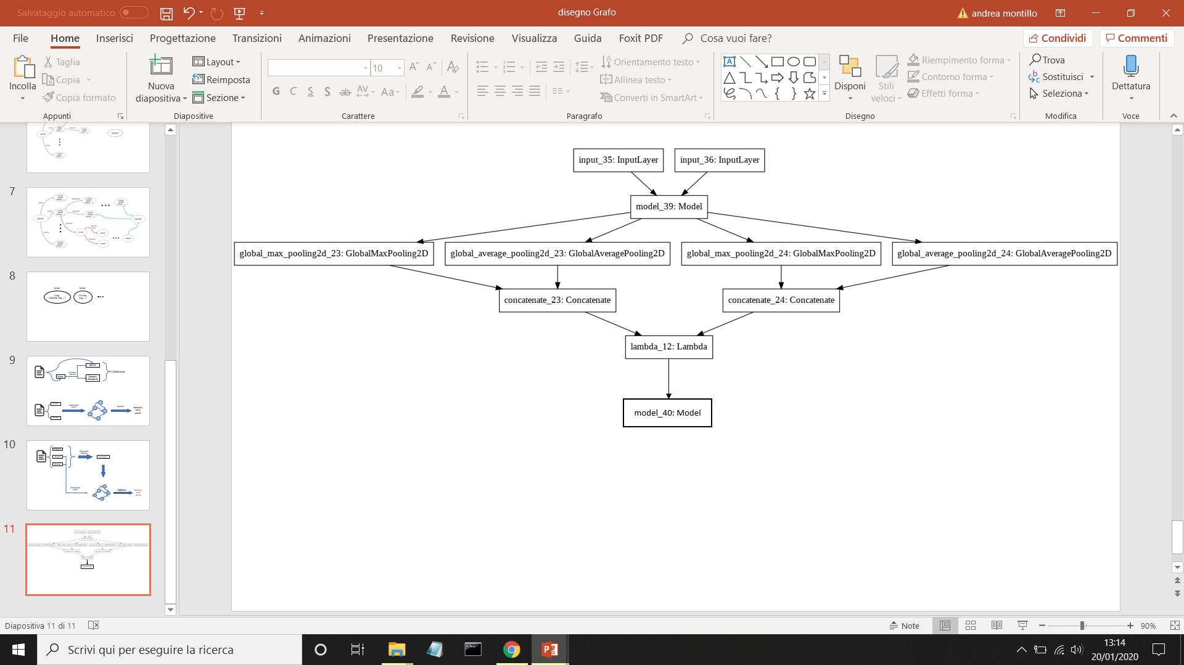
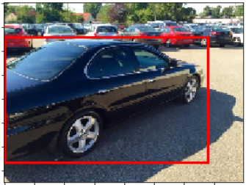
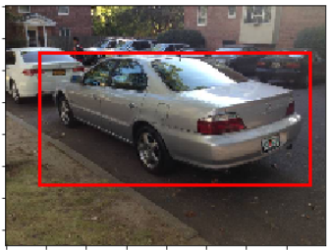
Used tecnologies
YOLO detector
Siamese model
CNN Network
(MobileNet)
Absolute difference
Dense + Dropout layers
Notes:
First of all we noticed that several images presents a very noise background
So, we decided to elaborate the images in input through YOLO, detecting the car
right car.
Once the car is detected we used the so-called "siamese model" to elaborate the
output. This kind of model is composed by an initial part for feature estraction
of the images. then these features are the input of different layers like the
absolute difference layer to compute how much are similar and finally the output
of the system is decided thanks to a Dense Network.

Slide 9
Typicall workflow
Yolo implementation:
the objects detected as «car» or as «truck» are considered
Among them the object with the biggest bounding box
If the bounding box is lower than the 25% of the image, it is discarded.
Y → two different model
Trained on all images of training set cutted to the dimension of detected car
Trained on all images of training set without using detection
During predict operation, if Yolo fails the second model is used, otherwise the first one
Yolo can fail !
Notes:
A problem could be that our usage of yolo can fail, in fact if there aren't
cars in the image according to Yolo, or if the car detected is too small
(probably because it belongs to the background of the image) then the detection
process is discarded.
So we decided to train two different model, one using the dataset with detection
discarding those images that fail in detection, the other using all images without
the detection process.

Slide 10
The model in detail

Slide 11
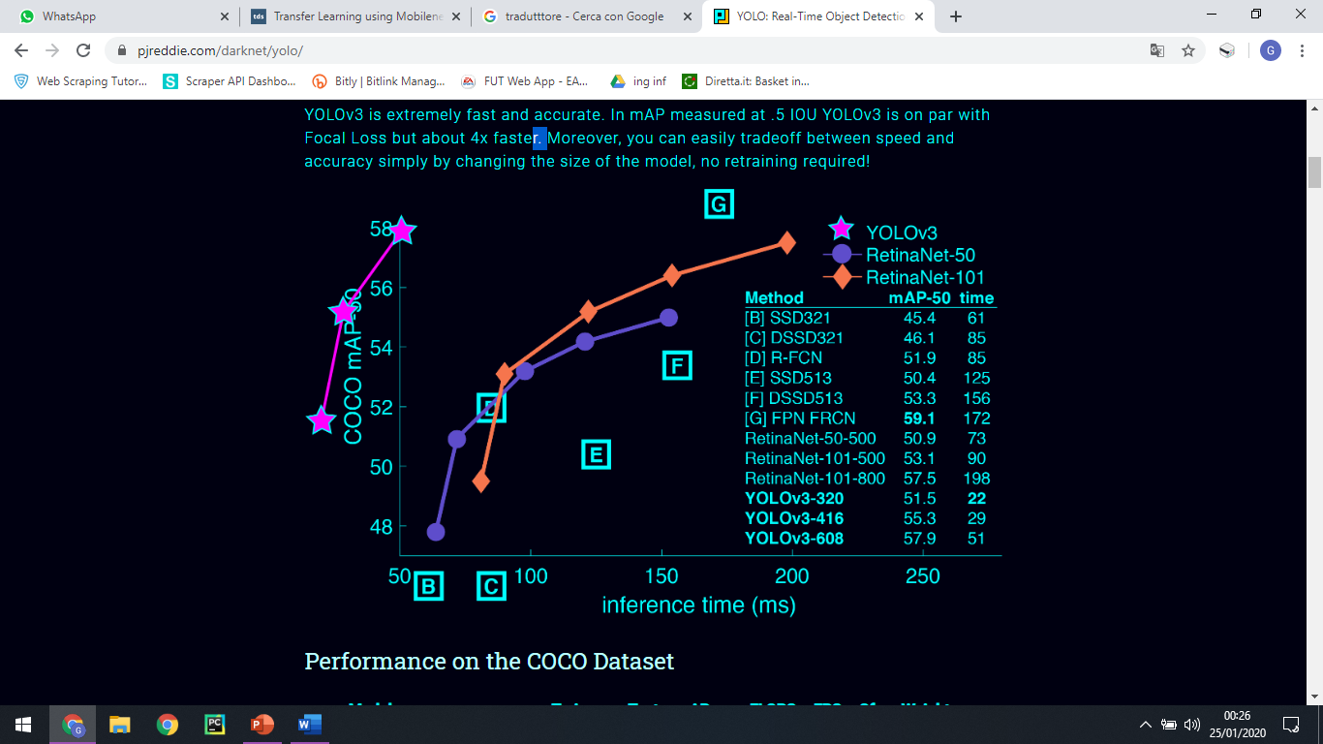
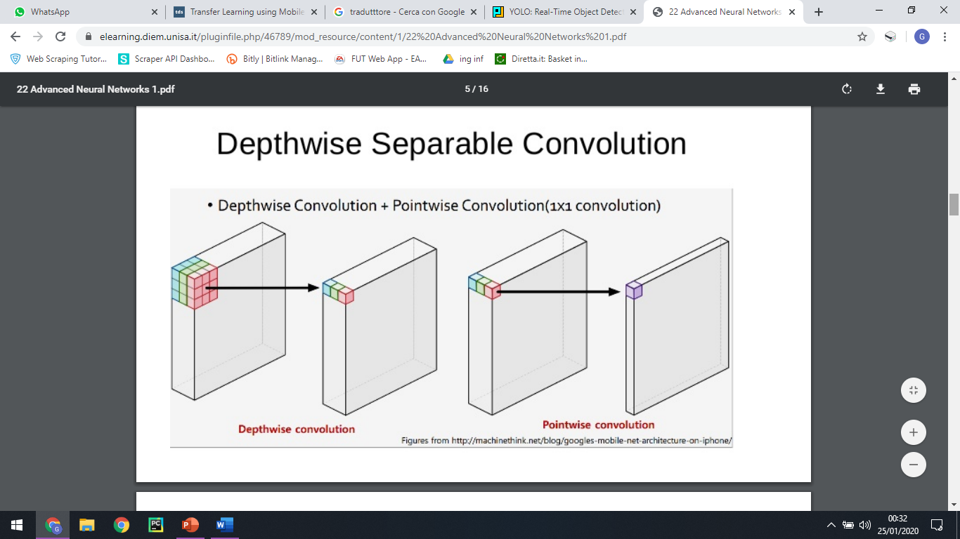
Classifier
Classifier
Yolo V3
Mobile net,
convolutional layer with stride 2
depthwise layer
pointwise layer that doubles the number of channels
depthwise layer with stride 2
pointwise layer that doubles the number of channels
Notes:
As we said, the architecture is based on an initial part of feature estraction. In order to obtain the best performance, we have used a object detector, in particular Yolo. We can see how it achieves the same performance as retinaNet but 4 times faster. Infact You only look once (YOLO) is a state-of-the-art object detection system. We have used the third version because is extremely fast and accurate. So we trained two classifiers, the first is used when a car within the image is identified, the second has been trained on the whole image, so that, if the detenction algorithm should fail, we could have good performance. We made this decision because we tested the system only with the network trained on the cropped images, and we noticed that in the event that the detenction algorithm failed, that same network could hardly make a correct prediction.
About the training, we have decided to use Mobilenet for its lightweight architecture. It uses depthwise separable convolutions which basically means divide the normal convolution into 2 substeps: the first is called depthwise convolution and that only workds on a spatial dimension; this depthwise convolution is followed by a pointwise convolution that works on depth dimension. This procedure has the effect of drastically reducing computation and model size. So we have a structure that allows excellent performance with high speeds.
So, about training, we will use pre-trained weights as the model has been trained already on the Imagenet dataset and we have made fine tuning on our dataset with non-frozen layers so as to specialize the network for our purpose, ensuring that we don’t overgeneralized the network.

Slide 12
Siamese
First step:
Fine-Tuning on the classifier
Second step:
Evaluation of how the features of Siamese’s arms are similar:
Absolute value of the difference
Notes:
Now let’s talk about Siamese. We could split its structure in three different steps.
The first one consists in fine-tuning on the classifier that we have mentioned before. After that, there is the evaluation of the similarity between the Siamese’s arms. In particular, there is a Lambda Layer that allow us to wrap an arbitrary expression and for our goal we have used the absolute value of the difference between the two output of the arms.

Slide 13
The last step
4 Dense Layers of decreasing dimension
512, 256, 128, 32
Between one Dense and another one, Dropout Layer
Rate 0.25
Why these values?
After several test, the best in terms of number of epochs to achieve high performance
Notes:
Therefore, there are 4 Dense layers of decreasing dimension, in order to understand the previous result, interspersed with 4 Dropout layers of rate 0.25.
The motivation of these values is to be found in terms of time needed to achieve high performance.

Slide 14
Performance Evaluation
Evaluation of the model and some alternatives
Notes:
And so, it’s now possible to take a look at the Performance.

Slide 15
Results obtained
Notes:
In particular we divided the dataset in 70-20-10 percentage for train validation and test. Moreover, the second test set used is the fourty-thousand couples given to us for the contest.
In this slide we show only the three most representative results.
The first graph represents the best result, obteined when we have trained the CNN classifier, then we have used it in the Siamese net and at the end we have retrained all the system with all the inferenced training set.
The second result has been obtained when we have frozen the CNN classifier already trained and as we can see we don’t have good results but it is probably because we needed more time for training.
The last one represent the case when we avoid the usage of the classifier and so we trained all the system from scratch using the training set.

Slide 16
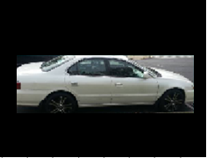
Other case studies
«Zero padding» the image after the detection of a car
Avoid the deformation of the car when resizing to 224 x 224
No Siamese but only classifier
Results were lower in general
Different kind of models for unified part of siamese and for the CNN
Notes:
We did also some other tentatives, for example we tried to avoid the resizing of the images using black-band surrounding the car
we also tried to use only classifier, so if the two image were of the same class then the output was one otherwise was zero
finally we obviously used different kind of layers in the system trying to reach the best results.

Slide 17
THANKS FOR YOUR ATTENTION!

